Slide 1
iPad Restaurant Application: Menus4U
Group: Heiren
Pawan Patel (100582283), Curtis Whall (100655399), Danial Asghar (100671850)

Slide 2
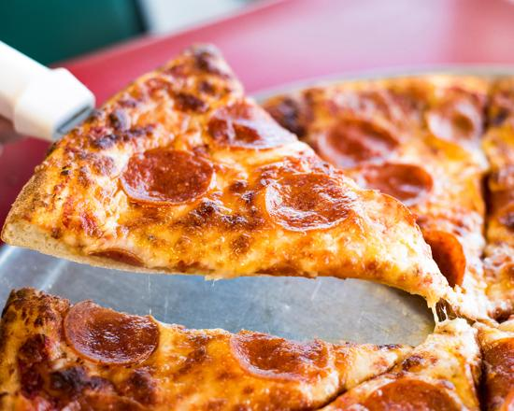

Menus4U, what is it?
Our software is an IOS application that can act as a replacement to traditional paper menus.
The goal is to completely replace the current system with the use of our app.

Slide 3
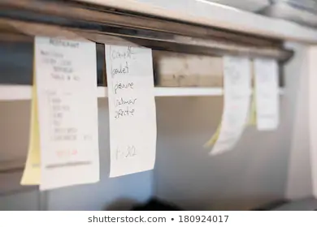

What does it do?
Instead of using waiters as the middleman of the kitchen to the customer, Menus4U will take orders and send them directly to the kitchen staff.
The app will allow customers to select food and order them, keeping a running total throughout their meal.
Orders will be sent to and printed out in the kitchen

Slide 4
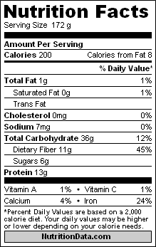

Key Functionalities
Menu with nutritional information as well as images or videos of the food
Built in secure payment methods that accept cards and online payments
Built in games or other activities to entertain guests

Slide 5
Infrastructure
iPads for each table within the restaurant
A database to store all food items sold - (Firebase)
iPad application to act as the menu
Printer to print orders within the kitchen
Their old system will connect to the firebase database hence allowing legacy support for older restaurants

Slide 6
Why create it?
Rising wages required for wait staff makes employers more likely to automate the process.
This opened up a new market, with the possibility of a huge profit.
Due to IOS development and previous knowledge with Swift, we thought this project was well suited to our team.
Overall, it can simplify and streamline restaurant experiences overall.

Slide 7
Measures of Success
Measure monthly profits and compare to previous years without extra wait staff. The number should be increasing and total staff wages should be decreasing.
Take customers surveys to see if language barrier issues have been improved since the implementation of the electronic menu.
Compare time for orders to reach the kitchen with the new system to traditional order taking. The new electronic system should have a noticeable improvement and result in quicker times.

Slide 8
Measures of Success
Once again use customer surveys to see if customer enjoyment has improved since the implementation of the new ordering system.
Number of compromised cards per year compared to previous years. Number should be decreasing.
Correct and up to date health information is available at all times during the ordering process to customers.

Slide 9
Risks and Our Preventions
Unqualified workers for the tasks required for development.
WIth the use of a strong recruiter and project lead, we can look at people for their strengths and create a team that fits our needs for this project.
On deployment, and during normal use, if the systems go down, or the app for the iPads does not work.
Have paper menus as backup in case .
Deadline not reached due to unforeseen circumstances. (Not Including unproductive work).
Paper menus as backup to keep the restaurant running.

Slide 10
Risks and Our Preventions
Worker sickness/injury/leave for any reason
Have backup workers who keep track of the project so that they can more easily be caught up if they are required to work due to a lost team member.
Possible requirements change
This seems unlikely due to the requirements but with an agile process of development we will be able to adapt to any changes.
Sluggish and unproductive work from employees.
Specific recruitment and strict job requirements to ensure deadline is met and quality is sufficient.

Slide 11
Risks and Our Preventions
Sluggish and unproductive work from employees.
Specific recruitment and strict job requirements to ensure the deadline is met and quality is sufficient.
Integration of kitchen and dining room tools
Test in house the workings between the two products, to ensure cohesion and that everything is working as intended before the deadline.
Lack of leadership or overall design of the project.
Strong leader as well as very detailed requirements initially to ensure the workers know where they are, and the goal that is to be reached. Also, meetings with the clients to ensure requirements are being understood and implemented as desired.

Slide 12
Risks and Our Preventions
Going over budget before completing the product
Strict budgeting and cost estimation done beforehand to ensure that workers know the limits that can be spent and hours worked.
Project estimation is not accurate or makes sense.
Strict time estimation and effort estimation to be done during planning phases to ensure streamlined development phase.

Slide 13
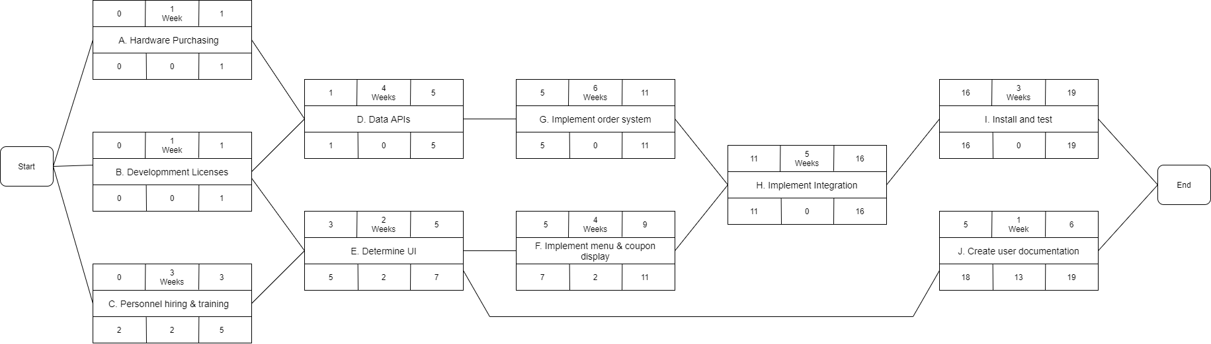
Activity Diagram

Slide 14
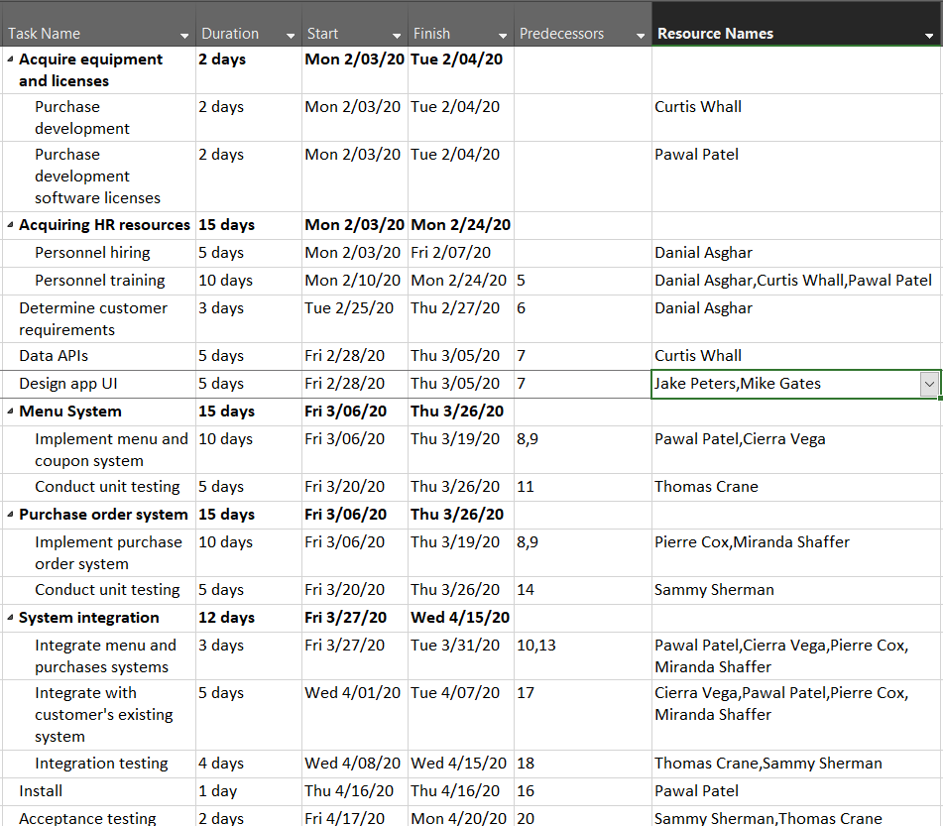
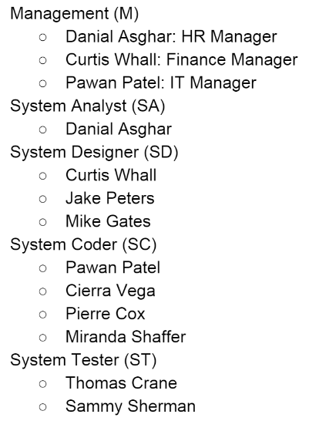
Assigned
Resources

Slide 15
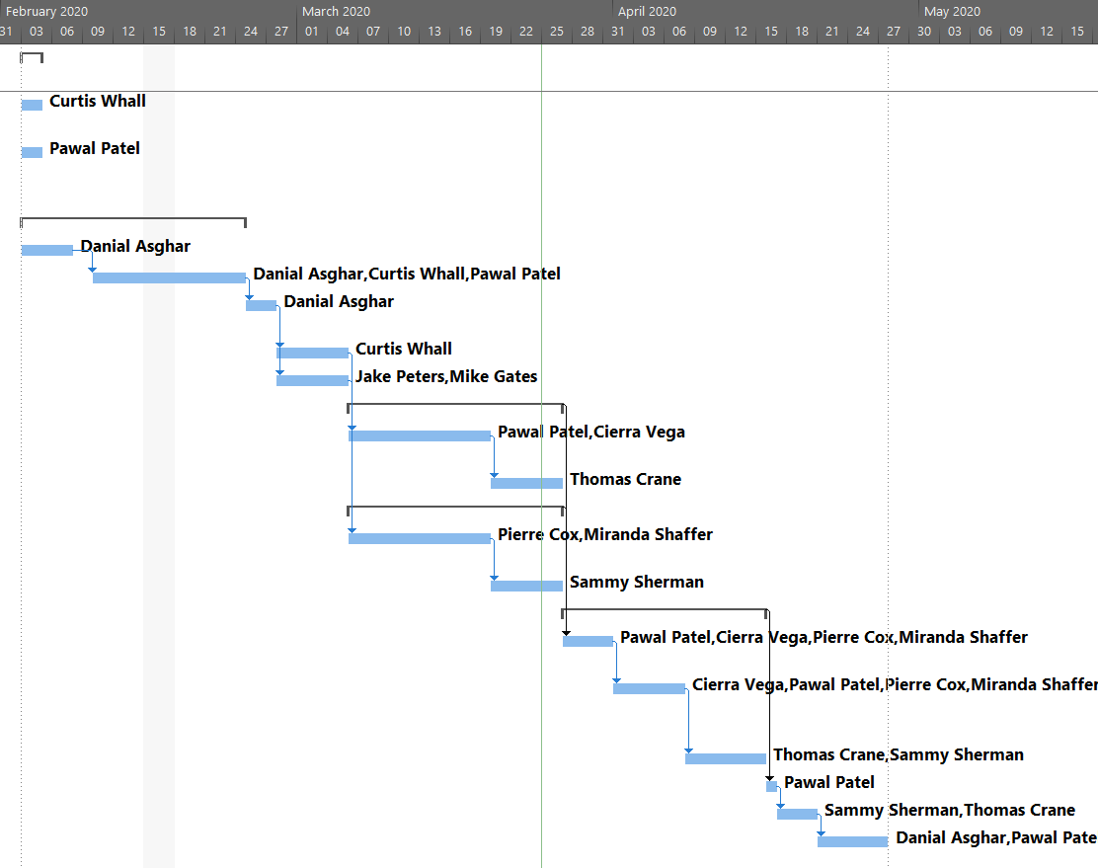
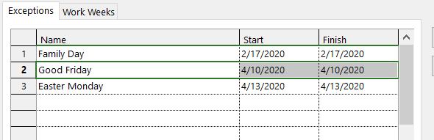
Gantt Chart
Holiday Exceptions ↓

